Slide 1

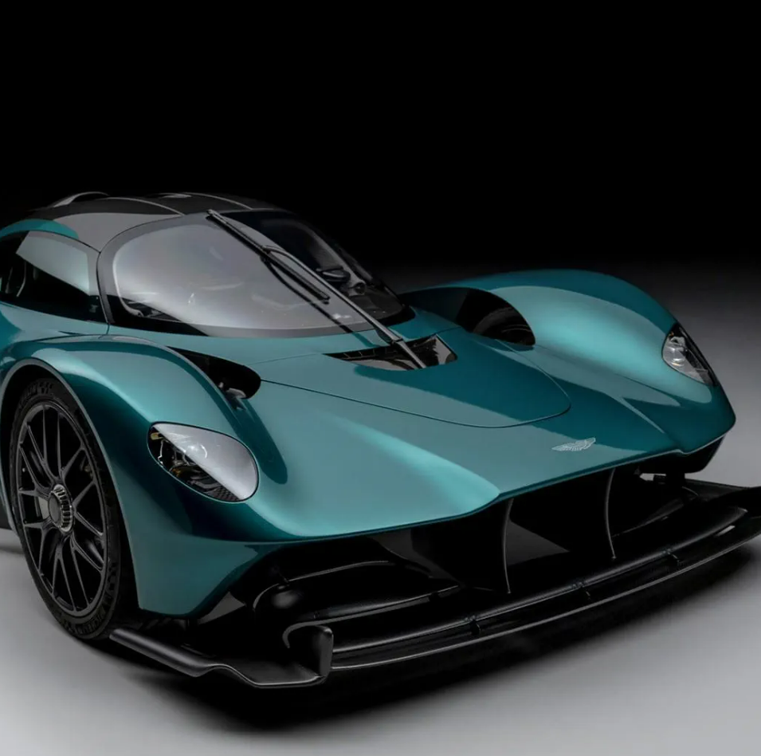
Aston Martin Valkyrie
Manufacturer: Aston Martin
Top Speed: Approximately 250 mph (402 km/h)
Launch Date: 2020
Engine: Cosworth-developed 6.5-liter V12 naturally aspirat- ed engine
Torque: Approximately 757 lb.-ft (1,027 Nm)

Slide 2

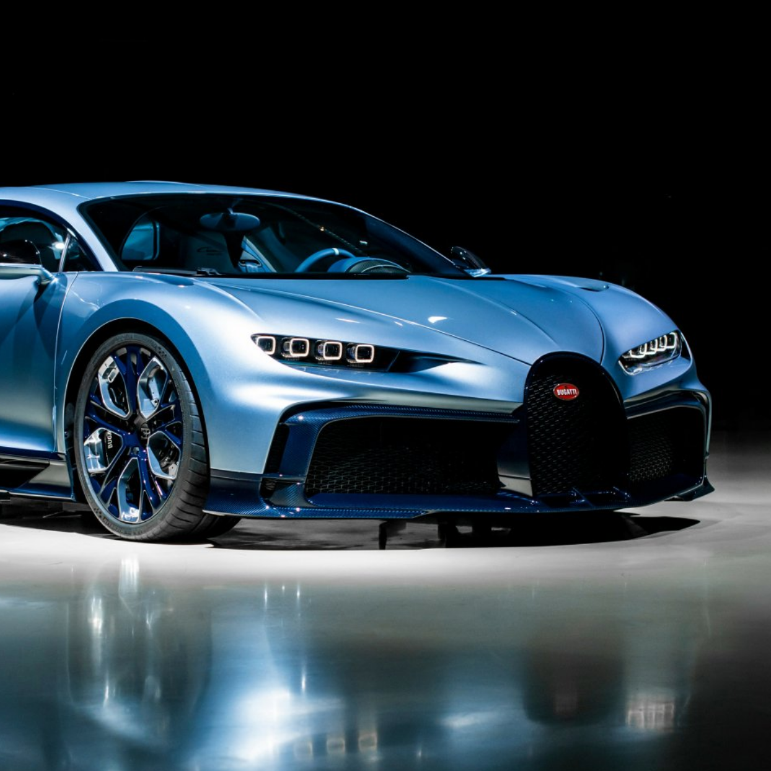
Bugatti Chiron
Manufacturer: Bugatti
Top Speed: Approximately 261 mph (420 km/h)
Launch Date: 2016
Engine: 8.0-liter quad-turbo charged W16 engine
Torque: Approximately 1,180 lb.-ft (1,600 Nm)

Slide 3
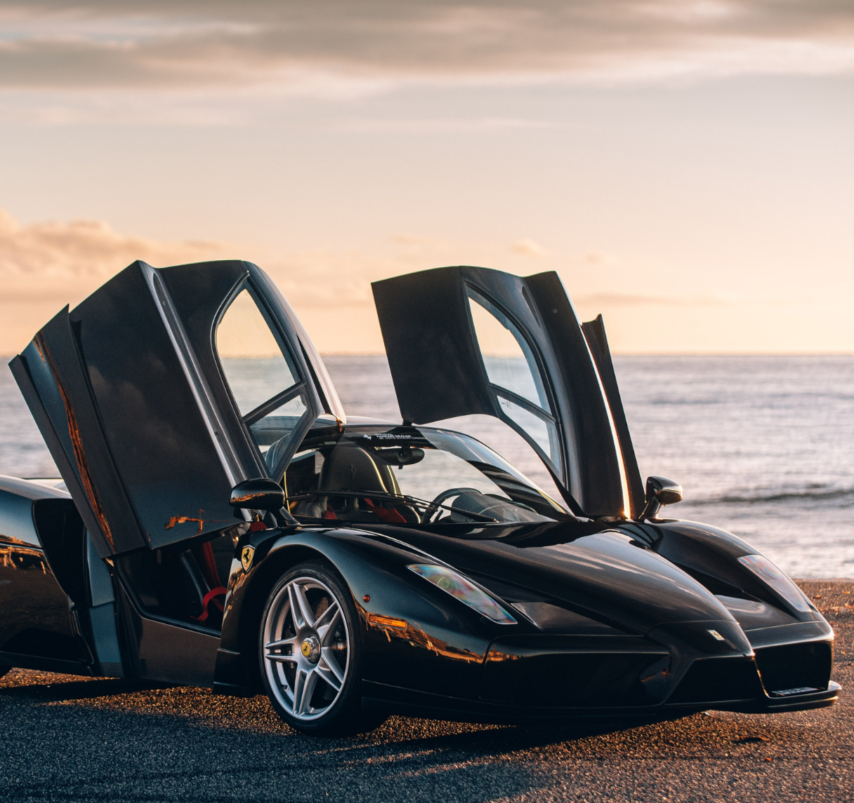
Ferrari Enzo
Manufacturer: Ferrari
Top Speed: Approximately 218 mph (350 km/h)
Launch Date: 2002
Engine: 6.0-liter V12 naturally aspirated engine
Torque: Approximately 485 lb.-ft (658 Nm)

Slide 4
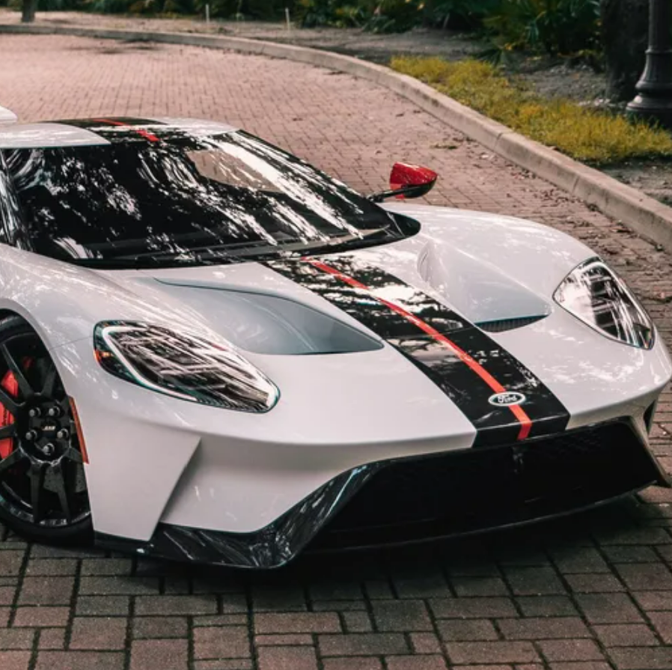
Ford GT
Manufacturer: Ford
Top Speed: Approximately 216 mph (348 km/h)
Launch Date: 2020
Engine: 3.5-liter twin-turbocharged V6 engine
Torque: Approximately 550 lb.-ft (746 Nm)

Slide 5
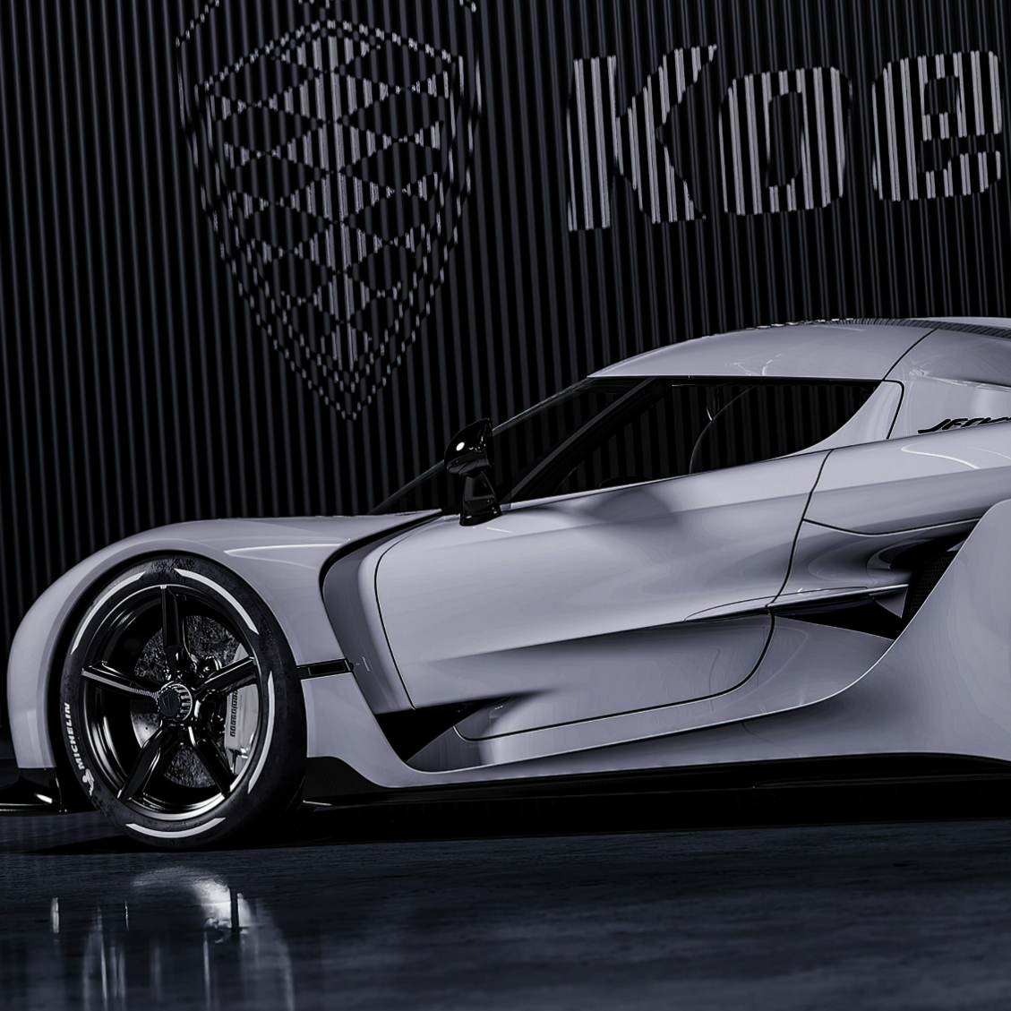
Koenigsegg Jesko
Manufacturer: Koenigsegg
Top Speed: Approximately 300 mph (482 km/h)
Launch Date: 2020
Engine: 5.0-liter twin-turbocharged V8 engine
Torque: Approximately 1106 lb.-ft (1,500 Nm)

Slide 6

Lamborghini Aventador
Manufacturer: Lamborghini
Top Speed: Approximately 217 mph (350 km/h)
Launch Date: 2011
Engine: 6.5-liter V12 naturally aspirated engine
Torque: Approximately
509 lb.-ft (690 Nm)

Slide 7
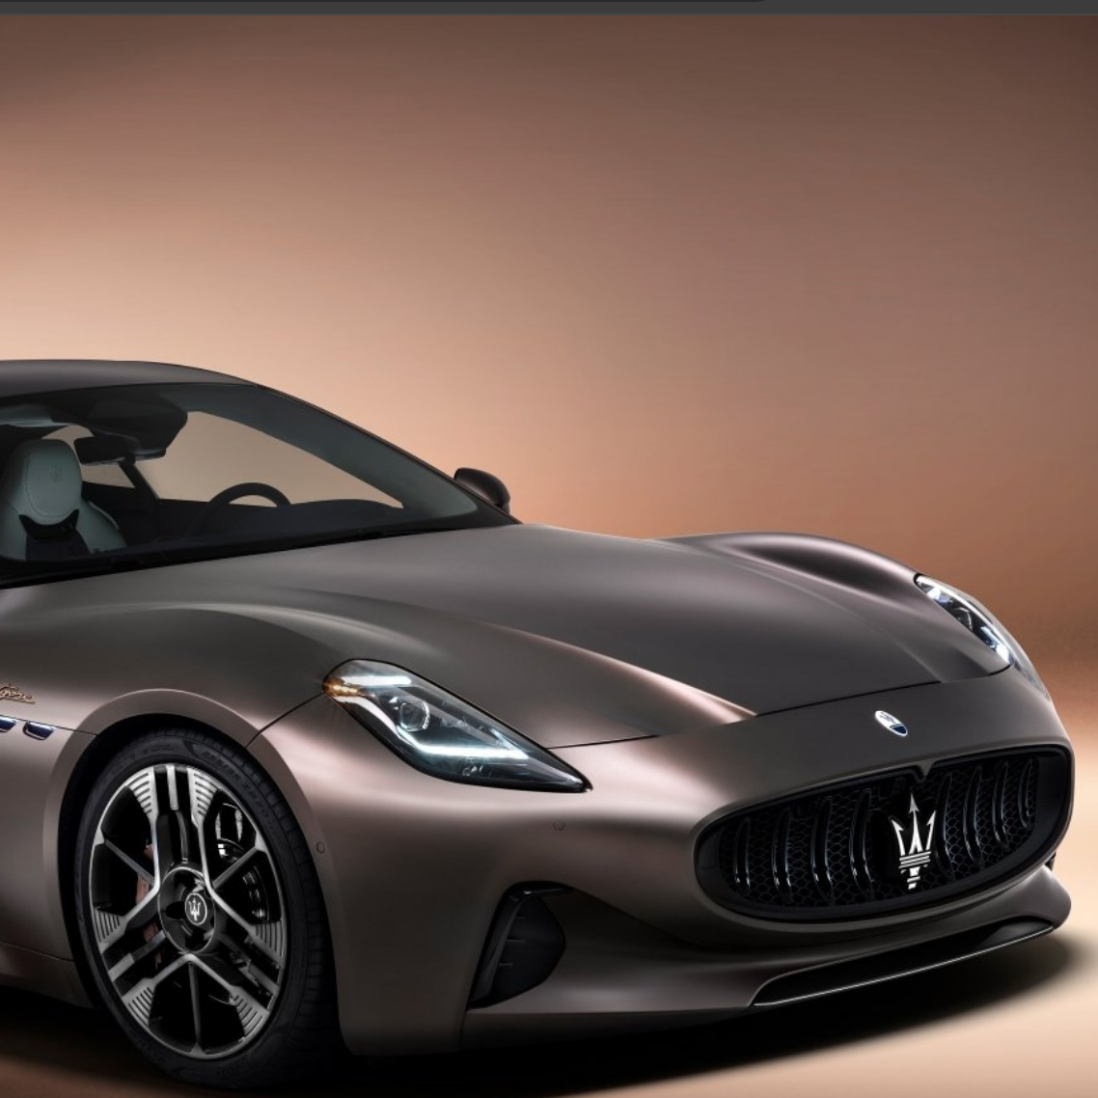
Maserati GranTurismo
Manufacturer: Maserati
Top Speed: Approximately 186 mph (299 km/h)
Launch Date: 2007
Engine: 4.7-liter V8 naturally aspirated engine
Torque: Approximately
361 lb.-ft (490 Nm)

Slide 8
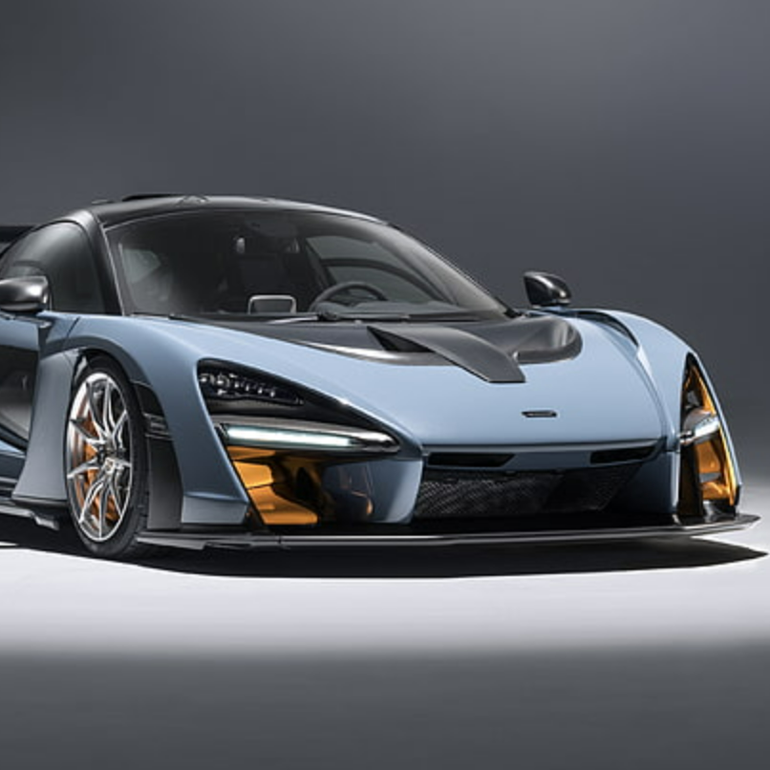
McLaren Senna
Manufacturer: McLaren
Top Speed: Approximately 208 mph (335 km/h)
Launch Date: 2018
Engine: 4.0-liter twin-turbocharged V8 engine Torque: Approximately 800 lb.-ft (1,085 Nm)

Slide 9
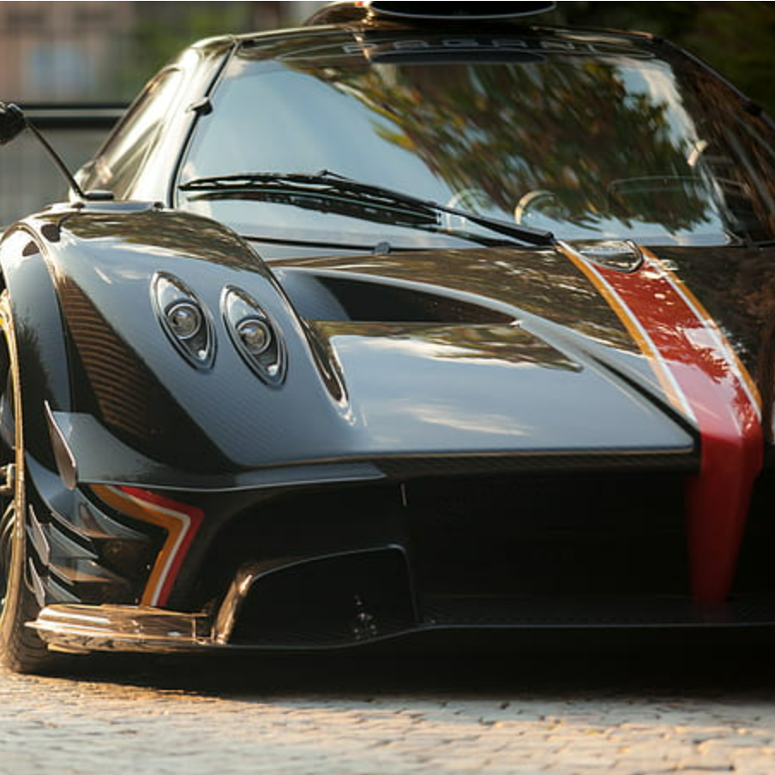
Pagani Huayra
Manufacturer: Pagani
Top Speed: Approximately 238 mph (384 km/h)
Launch Date: 2012
Engine: 6.0-liter twin-turbocharged V12 engine Torque: Approximately 738 lb.-ft (1,000 Nm)

Slide 10
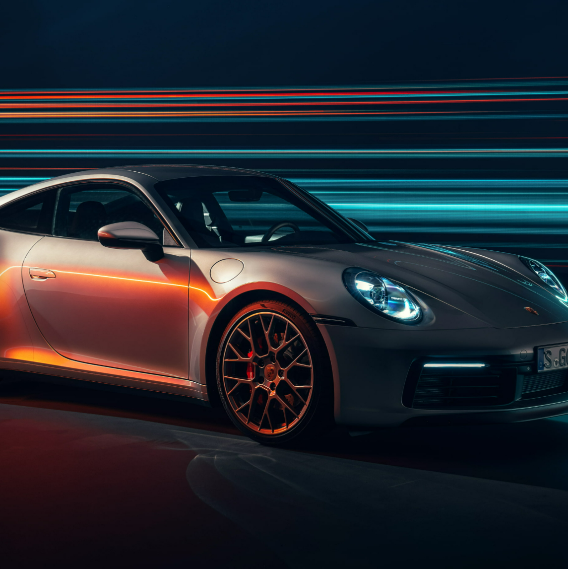
Porsche Carrera
Porsche Carrera
Manufact. :Porsche Carrera
Top Speed: Approximately 182 mph (292 km/h)
Launch Date: 2020
Engine: 3.0-liter turbocharged flat-six engine
Torque: Approximately 331 lb.-ft (450 Nm)

Slide 11
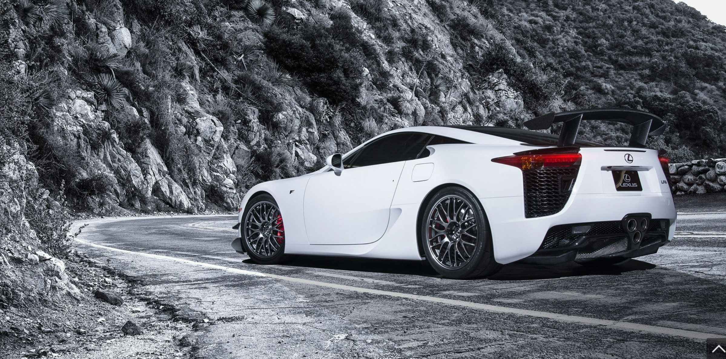
Lexus LFA
Manufacturer: Lexus
Top Speed: Approximately 202 mph (325 km/h)
Launch Date: 2010
Engine: 4.8-liter V10 naturally aspirated engine
Torque: Approximately 354 lb.-ft (480 Nm)

Slide 12
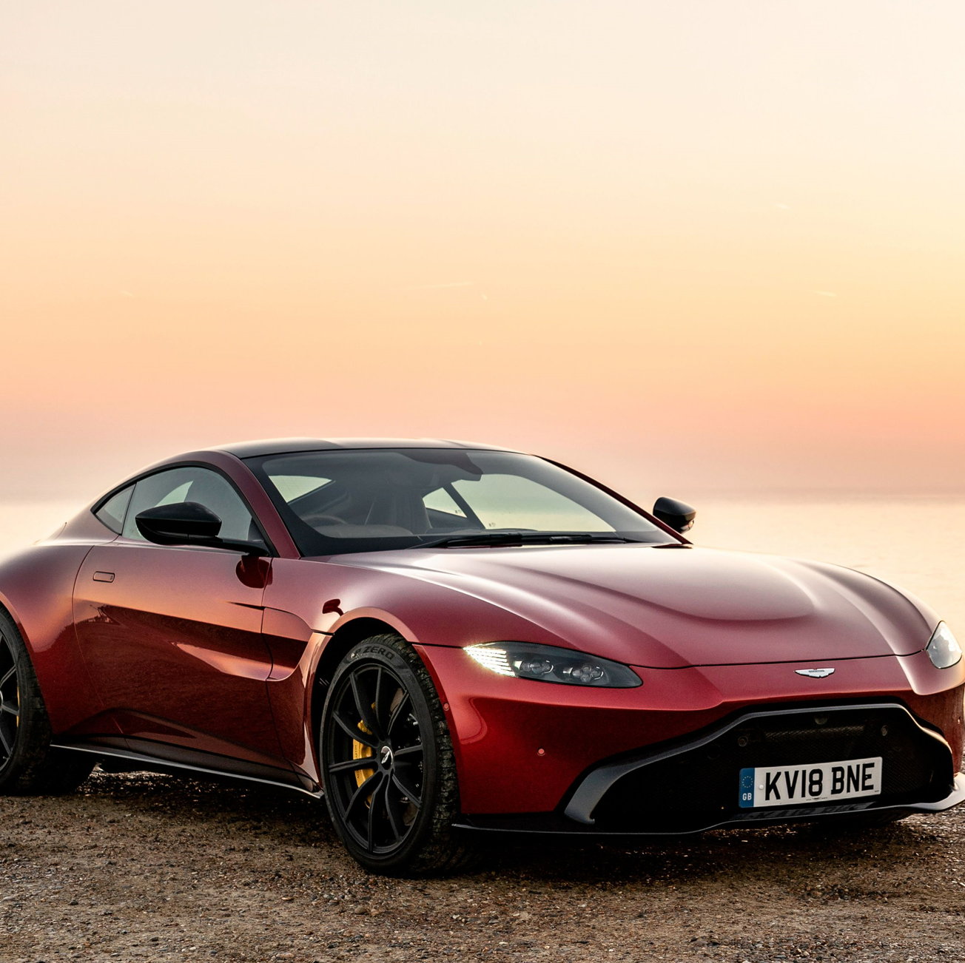
Aston Martin Vantage
Manufacturer: Aston Martin
Top Speed: Approximately 195 mph (314 km/h)
Launch Date: 2018
Engine: 4.0-liter twin-turbocharged V8 engine
Torque: Approximately 505 lb.-ft (685 Nm)

Slide 13
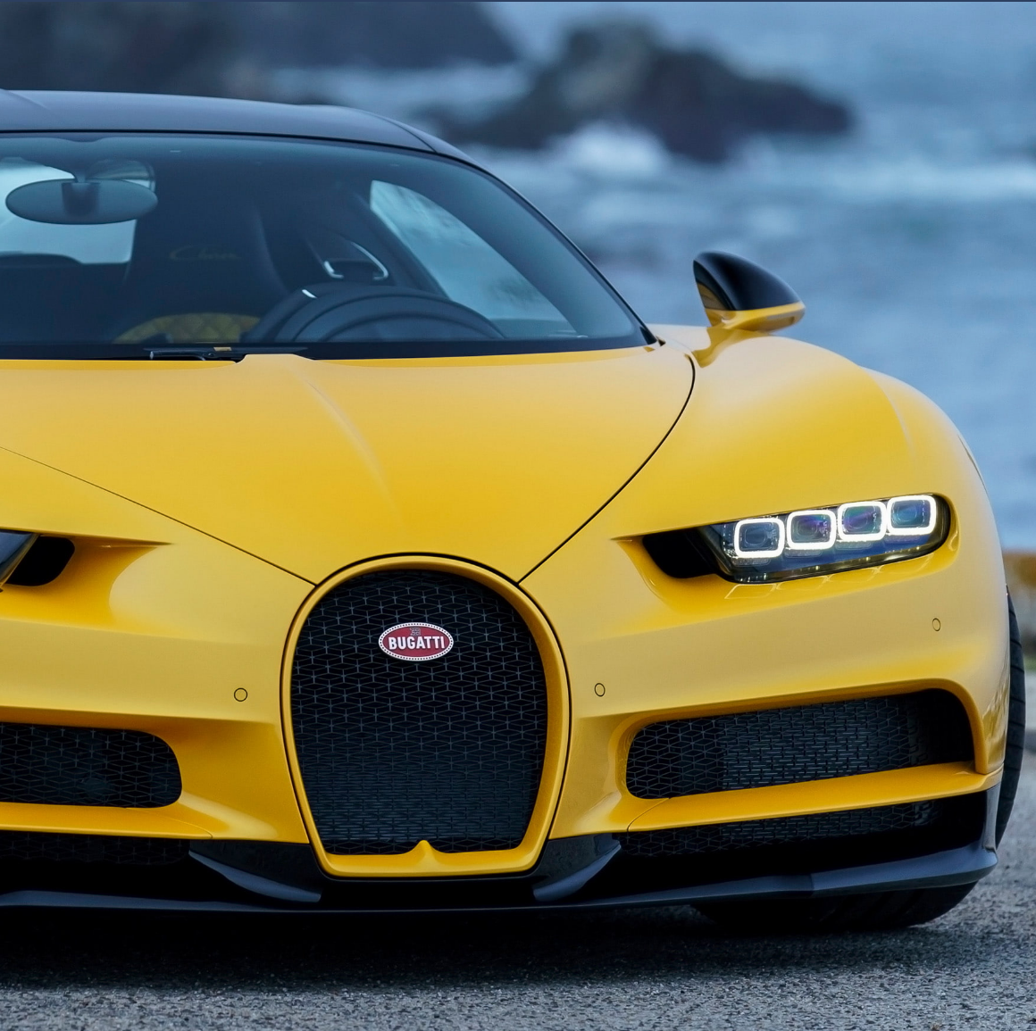
Bugatti Veyron
Manufacturer: Bugatti
Top Speed: Approximately 253 mph (407 km/h)
Launch Date: 2005
Engine: 8.0-liter quad-turbo charged W16 engine
Torque: Approximately 1,016 lb.-ft (1,500 Nm)

Slide 14
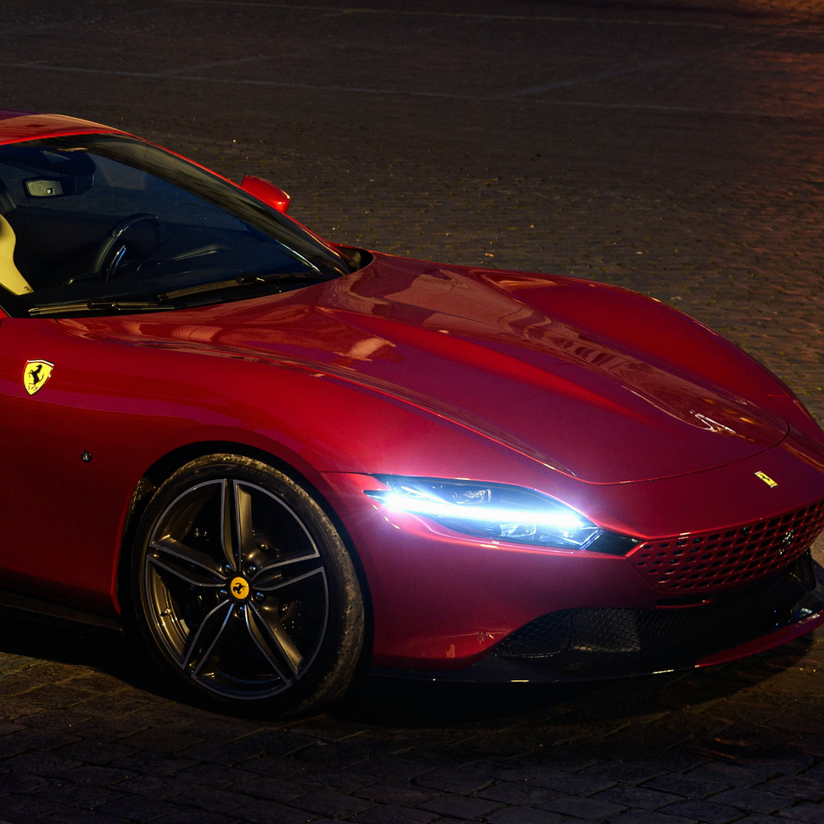
Ferrari Roma
Manufacturer: Ferrari
Top Speed: Approximately 199 mph (320 km/h)
Launch Date: 2002
Engine: 3.9-liter twin-turbocharged V8 engine Torque: Approximately 561 lb.-ft (760 Nm)

Slide 15

Lamborghini Huracan
Manufacturer: Lamborghini
Top Speed: Approximately 202 mph (325 km/h)
Launch Date: 2014
Engine: 5.2-liter V10 naturally aspirated engine
Torque: Approximately
443 lb.-ft (600 Nm)

Slide 16
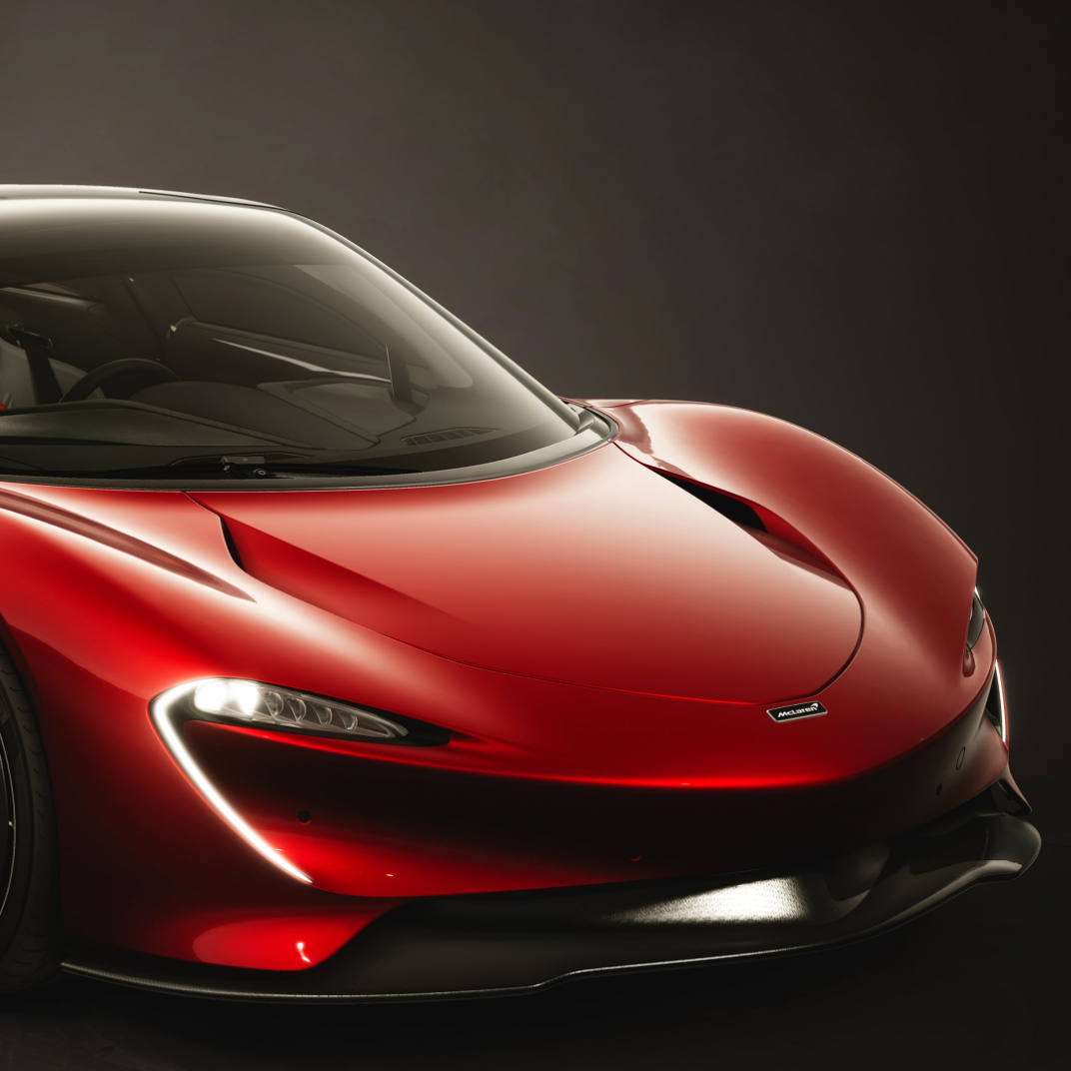
McLaren Speedtail
Manufacturer: McLaren
Top Speed: Approximately 250 mph (403 km/h)
Launch Date: 2020
Engine: 4.0-liter twin-turbocharged V8 engine with hybrid assistance
Torque: Approximately 848 lb.-ft (1,150 Nm)

Slide 17
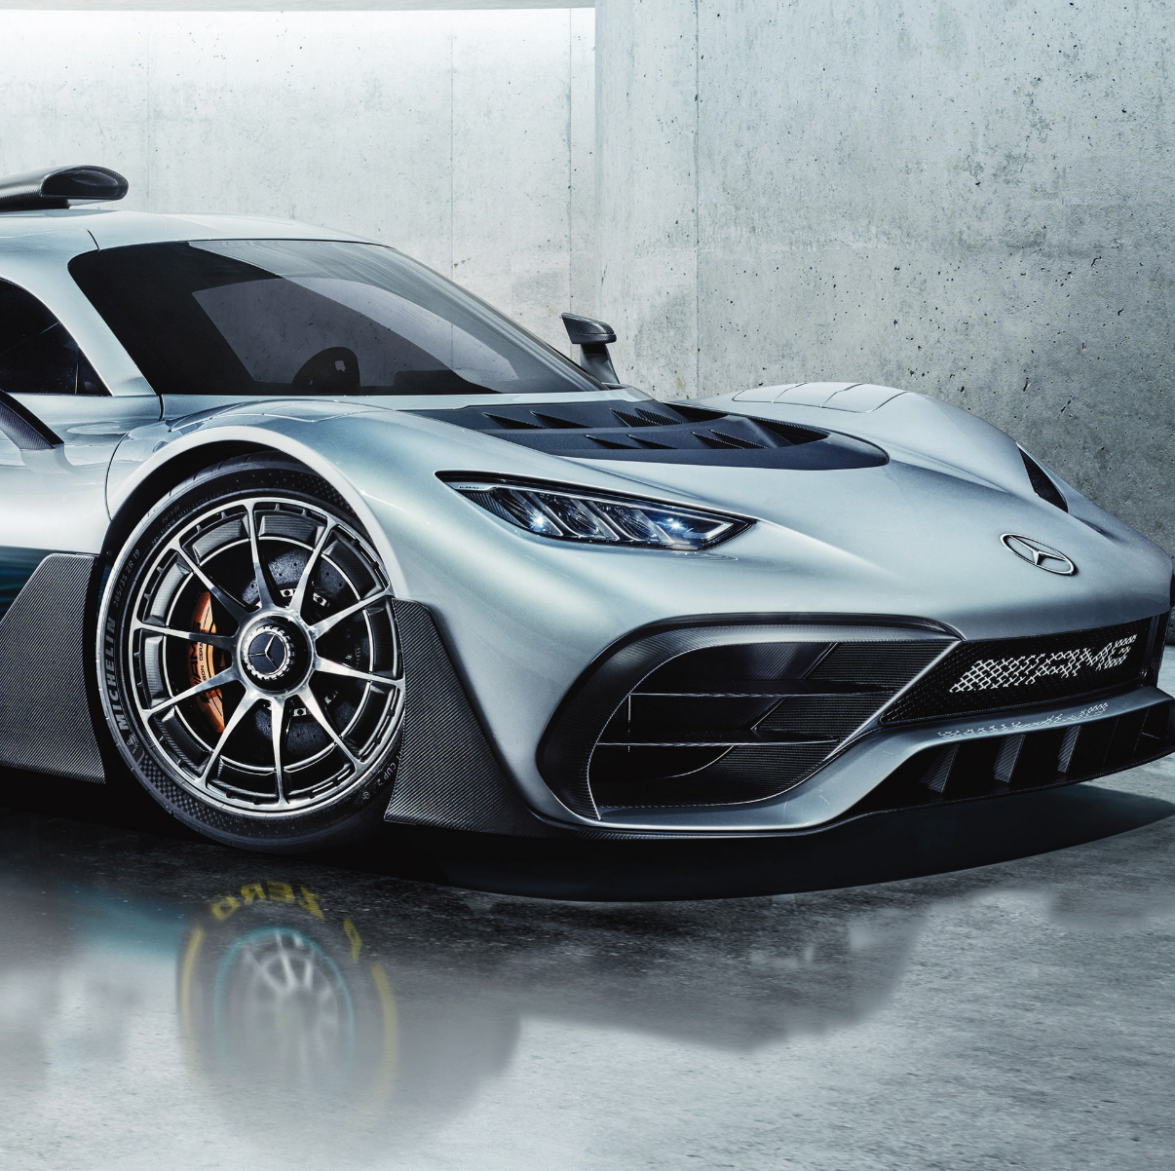
Mercedes AMG one
Manufacturer: Mercedes
Top Speed: Approximately 217 mph (350 km/h)
Launch Date: 2023
Engine: 1.6-liter turbocharged V6 hybrid engine
Torque: Approximately 738 lb.-ft (1,000 Nm)

Slide 18
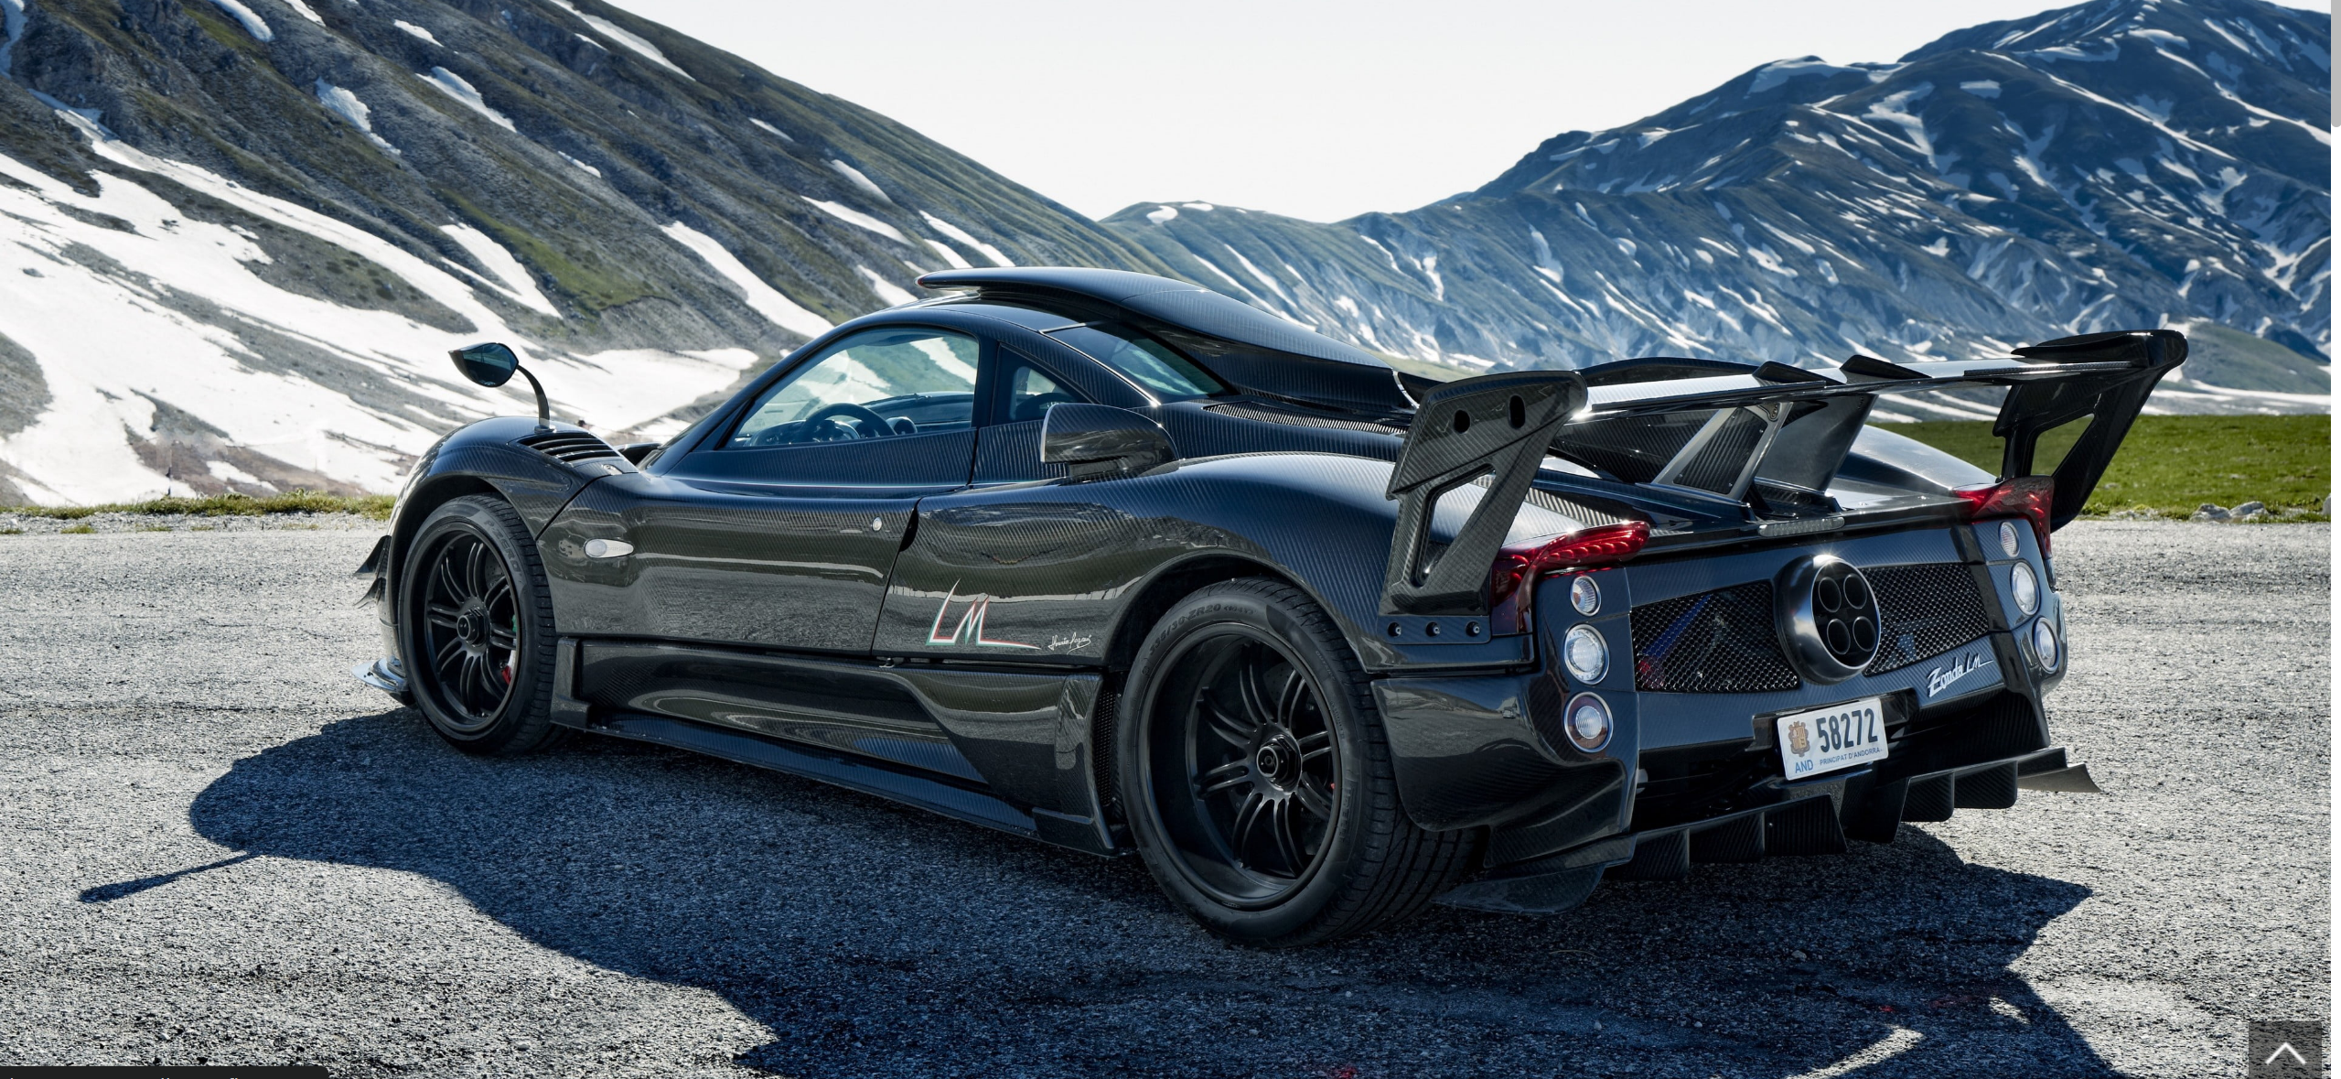
Pagani Zonda
Manufacturer: Pagani
Top Speed: Approximately 217 mph (350 km/h)
Launch Date: 1999
Engine: 7.3-liter V12 naturally aspirated engine
Torque: Approximately 750 lb.-ft (1,020 Nm)

Slide 19
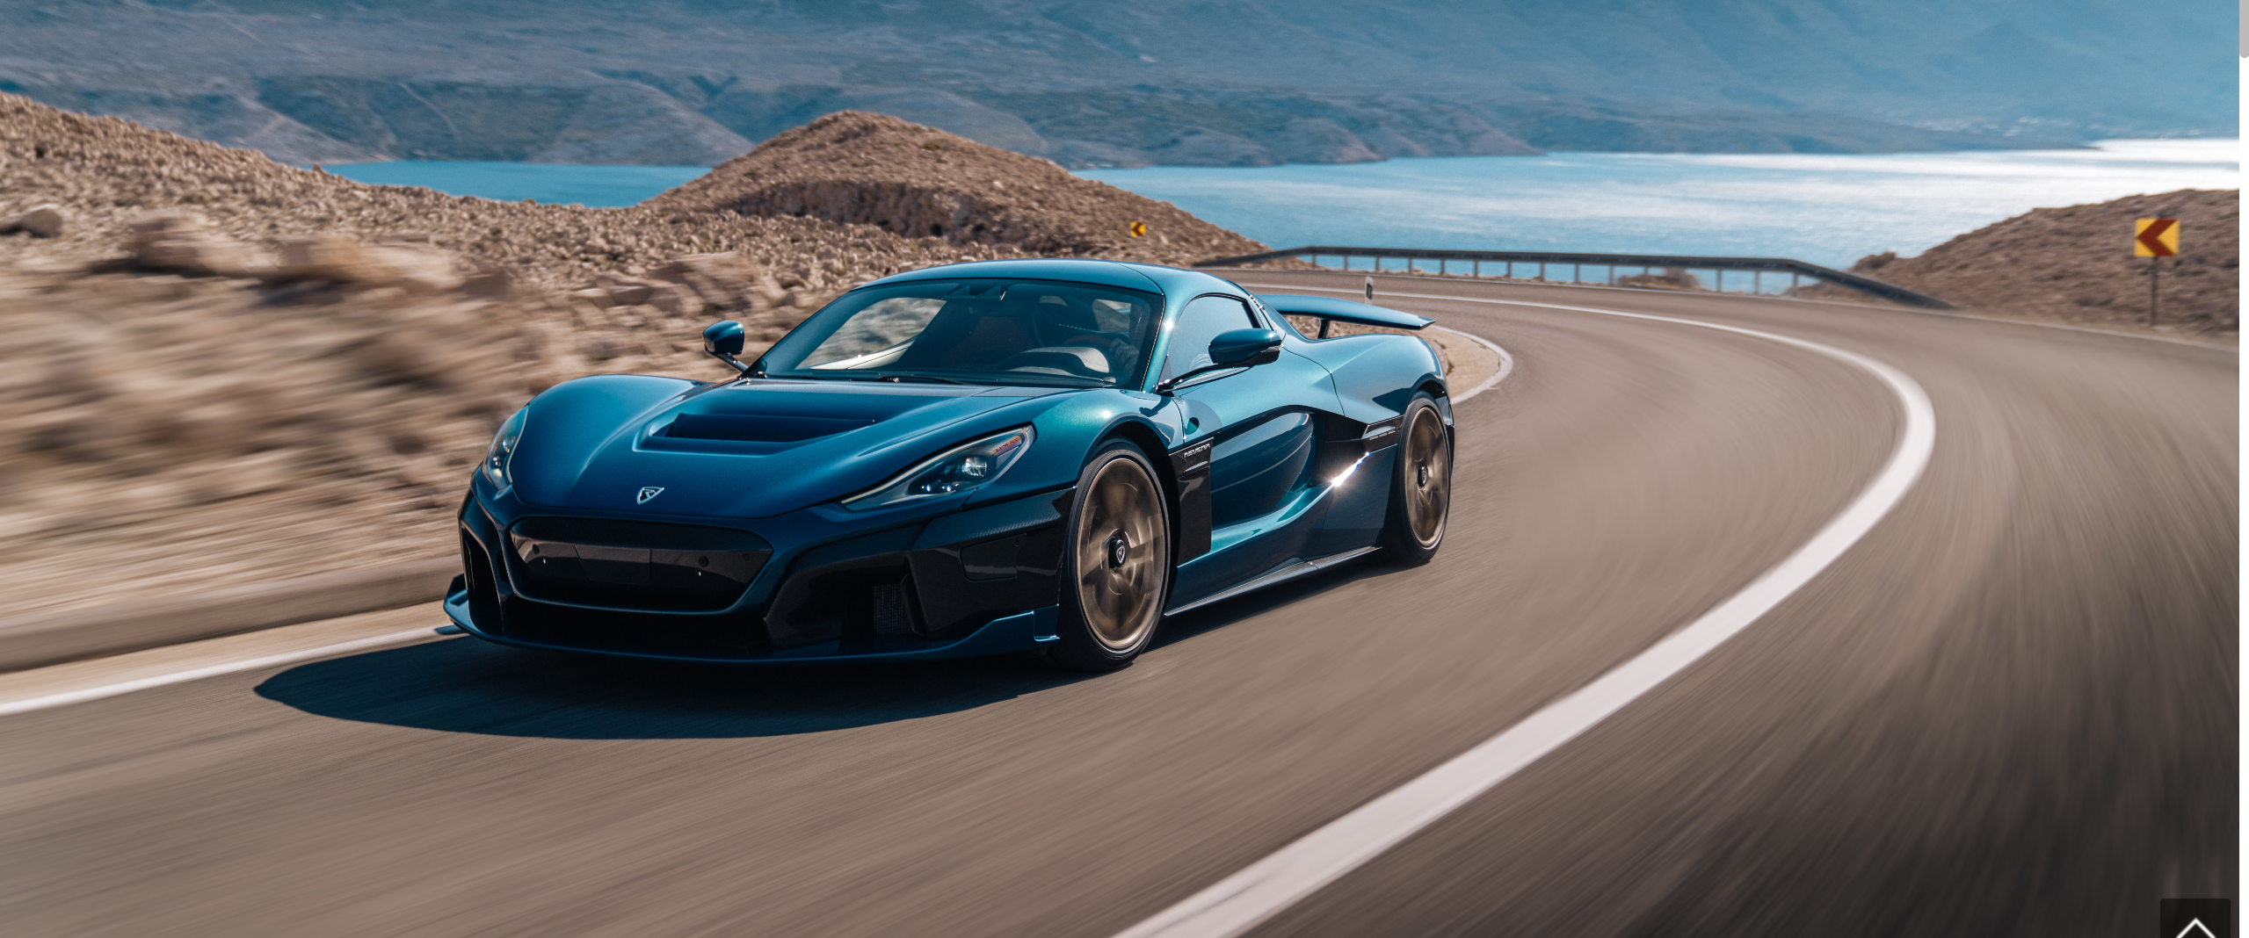
Rimac Nevera
Aston Martin Valkyrie
Manufacturer: Aston Martin
Top Speed: Approximately 250 mph (402 km/h)
Launch Date: 2020
Engine: Cosworth-developed 6.5-liter V12 naturally aspirat- ed engine
Torque: Approximately 757 lb.-ft (1,027 Nm)
Manufacturer: Rimac
Top Speed: Approximately 258 mph (412 km/h)
Launch Date: 2021
Engine: Four electric motors
Torque: Approximately 1740 lb.-ft (2,360 Nm)

Slide 20
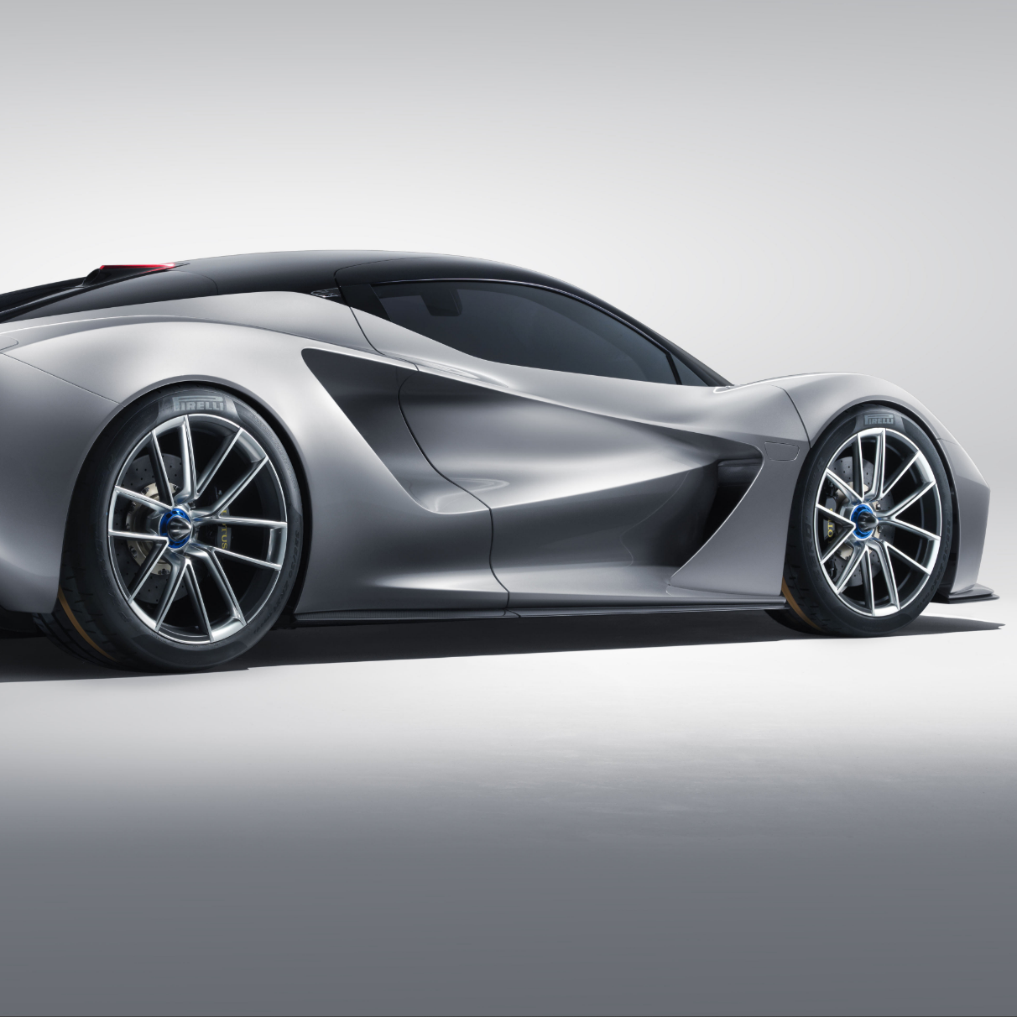
Lotus Evija
Manufacturer: Lotus
Top Speed: Approximately 200 mph (322 km/h)
Launch Date: 2020
Engine: Four electric motors
Torque: Approximately 1254 lb.-ft (1,700 Nm)

